Slide 1
DIABETIC RETINOPATHY DETECTION & STAGE CLASSIFICATION USING MACHINE LEARNING
NAME: TAJRIAN MAHBUB
ID: 20101325
GROUP: 11
ST: Saidul Arefin Rafi
RA: Md. Sabbir Hossain

Slide 2
INTRODUCTION
Welcome to our presentation on "Detecting Diabetic Retinopathy: A Deep Learning Approach." I will explore the significance of early DR detection and the potential of advanced machine learning and deep learning techniques to improve diagnostic accuracy.
Diabetic Retinopathy (DR) is a rapidly increasing global concern, affecting millions and causing significant vision impairment. According to the World Diabetes Federation, the number of DR patients is projected to reach 700 million by 2045, underscoring the urgency for early detection and treatment.
Traditional methods for DR detection often suffer from limitations in identifying the disease at its early stages, leading to delayed interventions and vision loss. However, the rise of cutting-edge technologies, such as ResNet, DenseNet, and EfficientNet, combined with traditional classifiers like SVM and KNN, has shown promising results in accurately detecting DR.
This presentation will highlight various research studies that have successfully utilized deep learning architectures on diverse datasets like Kaggle, Messidor, and APTOS 2019. These studies achieved impressive accuracies and sensitivities in classifying DR stages and identifying specific features like blood vessels and microaneurysms.

Slide 3
LITERATURE SURVEY
01
02
03
04
R.S. Rajkumar et al.: Used a Transfer learning method with ResNet-50 model to classify normal and abnormal DR images from Kaggle dataset with 89.4% accuracy.
Rocky Yefrenes Dillak et al.: Developed a VGG model achieving 99.66% accuracy, 99% sensitivity, and 98% specificity on Messidor dataset, and 98% sensitivity, 97% specificity, and 98.43% accuracy on Kaggle dataset
Alan Lands et al.: Utilized ResNet, DenseNet129, and DenseNet169 achieving validation losses of 67%, 32%, and 21% respectively for DR detection.
Muhammad Hanif et al.: Employed EfficientNet-B4 (83.67% accuracy) and EfficientNet-B5 (83.89% accuracy) classifiers on Kaggle dataset.

Slide 4
LITERATURE SURVEY
05
06
07
08
Ahsan Habib Raj et al.: Designed a CNN to detect Blood Vessels and Microaneurysms with 95.41% accuracy on Kaggle dataset.
Mobeen-ur-Rehman et al.: Presented AlexNet, VGG-16, SqueezeNet CNN models with accuracies of 93.46%, 91.82%, and 94.49%, respectively. Also proposed a 5-layered CNN model with 98.94% sensitivity, 97.87% specificity, and 98.15% accuracy.
Anas Bilal et al.: Implemented a unique hybrid strategy with SVM, KNN, and binary trees achieving 98.06% accuracy, 83.67% sensitivity, and 100% specificity.
Yasashvini R et al.: CNN model with ResNet and DenseNet classifiers achieved 96.22% accuracy on ResNet and 93.18% on DenseNet for DR detection

Slide 5
PROPOSED SYSTEM FOR DR DETECTION
DATA
ACQUISITION
IMAGE
PRE-
PROCESSING
FEATURE EXTRACTION
CLASSIFY &
OUTPUT

Slide 6

IMPLEMENTATION
The dataset used in this study consists of 3,662 retinal images from Kaggle, split into 2,744 images for training and 546 images for testing. The severity of Diabetic Retinopathy (DR) in the images is rated from 0 to 4, representing normal, mild, moderate, severe, and non-proliferative DR stages. The dataset allows for the evaluation of the proposed DR detection system using machine and deep learning techniques.

Slide 7

IMPLEMENTATION
Image Pre-Processing:
Pre-processing is crucial for standardizing retinal images in the dataset due to significant noise caused by various factors such as poor focus, lighting issues, and background variations. The process includes eliminating dark backgrounds and black corners, resizing images to 256x256 for consistency, and normalizing using Gaussian blur to remove noise. These steps improve image quality and standardization for accurate diabetic retinopathy diagnosis.

Slide 8
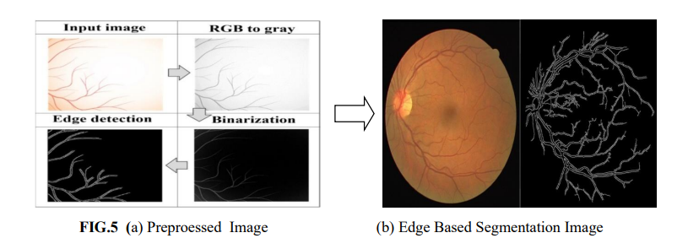
IMPLEMENTATION
Image Segmentation:
Image segmentation is crucial in detecting diabetic retinopathy by identifying regions in eye images. Edge-based segmentation is used to detect the edges of blood vessels in retinal images, a vital diagnostic feature for diabetic retinopathy. Morphological operations enhance image contrast and remove unwanted elements to identify relevant features. Edge-based segmentation provides an automated method to analyze abnormal blood vessels in the retina, making it valuable in managing diabetic retinopathy.

Slide 9
IMPLEMENTATION (Feature Extraction)
Process of identifying unique visual characteristics in retinal images.
Microaneurysms (MAs): Small outpouchings in blood vessel walls.
Hemorrhages (HEs): Areas of bleeding within the retina.
(4 FEATURES)
Optic Disc (OD): Point where optic nerve enters the eye.
Fovea: Central pit responsible for detailed vision.
Features are used for early detection of DR.
Fed into SVM classifier for identification.

Slide 10
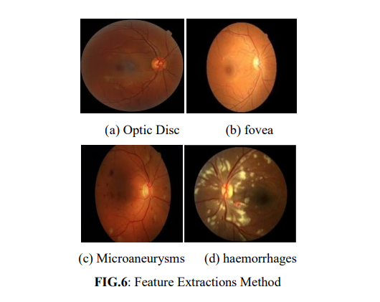
01

Slide 11
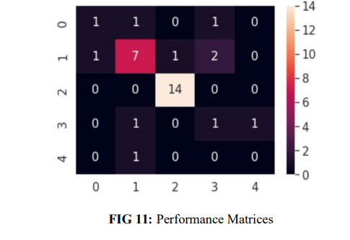
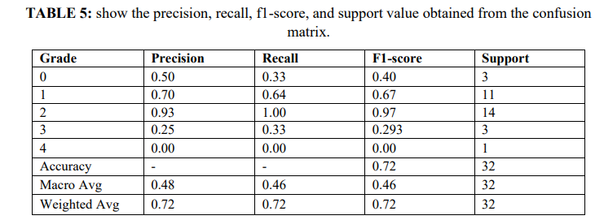
IMPLEMENTATION
Classification:
Two classifiers used: SVM and CNN.
CNN with convolutional and max pooling layers.
Images classified into five grades using softmax layer.
ReLU activation function used for non-linearity.
Performance Matrices:
Evaluated CNN performance for diabetic retinopathy.
Metrics: Accuracy, Precision, Recall, F1 score.

Slide 12
IMPLEMENTATION
SVM (Support Vector Machine):
Supervised ML algorithm for classification.
Identifies optimal boundary to separate classes.
Maximize margin between classes, minimize error.
Implementation:
Dataset split into features (x) and target (y).
Training and testing sets created.
SVM classifier trained with linear kernel.
Classifier used to predict test set classes.
Accuracy computed using accuracy score.

Slide 13
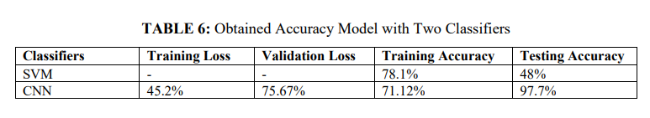
RESULT
In the paper, Google Collaboratory environment
is used for the investigation. It allows writing and
executing Python code in the browser, the
resource allocated for this work is 80 GB of disk
storage memory data. Finally, it is divided into
two sets, 80% is utilized to training, and 20% is
utilized to testing. The dataset composed of
totally 3662 images, in that 2744 images is
utilized for training and 546 images is used to
testing. The obtained results using two classifiers
CNN and SVM are shown in Table.

Slide 14
COMPARISON
Proposed Work:
Detect DR using ML and DL techniques.
Kaggle dataset used for training and testing.
Classifiers: CNN and SVM.
Comparison Results:
CNN accuracy: 97.7%, outperforms SVM.
CNN excels in accuracy, sensitivity, specificity.
CNN more suitable and effective for DR prediction from retinal fundus images.

Slide 15
THANKS!
Link of the paper:https://jptcp.com/index.php/jptcp/article/download/1903/1993

